Slide 1
Welcome to Gujarat Technological University
Organized Webinar on
Emerging career opportunities of
IP VALUATION AND MANAGEMENT
on
23th December 2015, Wednesday

Slide 2
INDEX
1) Overview of GTU
2) GTU IPR Cell activities
3) What is IP Valuation ?
4) Why IP Valuation is required ?
5) Government Initiative for IP Valuation
6) GTU Initiative
7) IPVM course outline
8) Eligibility & Fees Structure
9) Questions

Slide 3
GTU : Largest Technological University
GTU is the state level Technological University of Gujarat, started as per Gujarat Act 20 of 2007 on 16th May 2007.
GTU has more than 510 affiliated Engineering, Pharmacy, MBA and MCA colleges across the state of Gujarat.
Total number of students pursuing various degree/diploma program are more than 5.5 lac students

Slide 4
GTU IPR Cell Overview
Under the visionary leadership of Honb. Dr. Akshai K. Aggarwal, Vice chancellor, GTU has successfully organized more than 70 IPR awareness by organizing faculty workshops and student workshops on various themes.
GTU IPR Cell was started since 3rd September 2011.
So far trained 4860 faculty members and more than 3000 students of Engineering & Pharmacy directly.

Slide 5
GTU IP Cell Initiatives
1) Patenting in Pharmaceuticals
2) Patenting in Engineering
3) Patent Search Methodology
4) Patent Drafting Exercise
5) Patent Search & Analysis Report (PSAR)
6) Patent Drafting Exercise (PDE)
7) Patent Clinics
8) PatenTrack
9) Patent Search & Technology Landscaping

Slide 6
GTU IP Courses
1) Post Graduate Diploma in IPR (PGDIPR)
Started from Sept- 2014
Off Campus program, 12 months
1st batch over in August-2015 and 2nd batch started.
2 days in a month contact classes
Highest number of contact hours
Experts from India and Abroad
Placement support
Eligibility: Min. Science / technical graduation degree
Next batch will commense : Sept – 2016
Fees: Rs. 25,000/-

Slide 7
What is the meaning of IP Valuation ?

Slide 8
Kind of Property
Movable Property
Car, pen, furniture, dress…….
Immovable Property
Land, building……..
Intellectual Property
Literary works, inventions ……..

Slide 9
Intellectual Property Rights “Rights”
A moral or legal entitlement to have or do something.

Slide 10
Intellectual Property Rights “Property ”
A thing or things belonging to someone

Slide 11
Intellectual Property Rights
Relating to the intellect

Slide 12
Intellectual Property Rights
Very broadly, means the legal rights which result from intellectual activity in the
Industrial,
Scientific,
Literary and Artistic fields.

Slide 13
Nature
Intangible
Territorial
Quid pro quo
Limitations and Exceptions
Time-bound
Exclusive right / Monopoly
IP and competition law:- contradictory theory

Slide 14
Kinds
Copyright and Related Rights
Industrial Property
Patents
Industrial Designs
Trade marks & Geographical indications
Layout Designs of Integrated Circuits
Trade secrets
Protection of new plant varieties

Slide 15
Benefits of IP
Encourages
innovation
product development
technical change
Monetary gains to inventors.
Greater inflows of technology
Reduces imports

Slide 16
WHY……..??????
IP Valuation

Slide 17
Rationale
Valuation or Economic appraisal analysis is one of the most critical areas in finance; such as
Buy / Sell,
Pricing
Solvency, Merger and Acquisition.
Financing securitization and Collateralization,
Tax planning and Compliance,
Litigations support
Furthermore, it is considered as one of the most important management strategic issues

Slide 18
IP assets –
core of Organizations and Transactions.
Licenses and Assignments –
common operations,
Assets as loan security.
Economic value is a critical factor in order to define their trading conditions.

Slide 19
Valuation for Merger, Acquisition, JV or Bankruptcy
Most of the technological companies are highly based on IP assets.
Expenditures on knowledge, through investments in R&D or software, have grown at a higher rate than expenditures in tangible assets
Therefore, to know the value of companies it is essential to know the value of their IP.

Slide 20
Negotiations to sell or license IP Rights.
As in other business transactions, organizations negotiating agreements to sell or license IP and Patent rights commonly have to agree on a price.
Knowing the value of the IP rights is essential to reach such an agreement, but also to make sure the parties are engaging in a good deal.

Slide 21
Fund raising through Bank loans or Venture capital
Valuation of the IP to be used as security for bank loans or to attract venture capital and investors is essential.
Owning patents and a proper IP management play a crucial role in the decision of venture capitalists.

Slide 22
Support in situations of IP conflict or dispute
In scenario of IP conflict, such as infringement proceedings or Alternative dispute resolution mechanisms, quantification of damages is often a necessary step of the process.
The correct valuation of the IP right at stake is therefore essential to guarantee a fair recovery of the damages.

Slide 23
Assisting internal decision making for IP protection strategies
Valuation also plays a role on decisions concerning the IP strategies and country selection for registration of IP rights, or can assist organizations to identify weaknesses such as ownership uncertainties that have an impact in the value of the IP rights and on decisions for the exploitation of such assets.

Slide 24
Accounting and Taxation purposes
Valuation is a necessary step, in situations of tax planning.
Defining the objectives and context of the valuation is essential, since it determines the strategy as well as the type of valuation method that should be used.
This is therefore the first step to take when performing a valuation.

Slide 25
Approaches
The valuation process necessitates gathering information as well as in-depth understanding of
economy,
industry, and
specific business that directly affect the value of the IP.
Information may be gathered from external and / or internal sources.
IP value, like value of other property, may fluctuate over time, as markets change.

Slide 26
Central Government initiative
Central Government is very keen to introduce policy to provide loan to innovators who have their own IP (Intellectual property like Patent, Copyright, Design, Trademark etc). One related article published on 16th December 2015 in The Economic Times: http://goo.gl/xJiDSt
Creative India, Innovative India

Slide 27
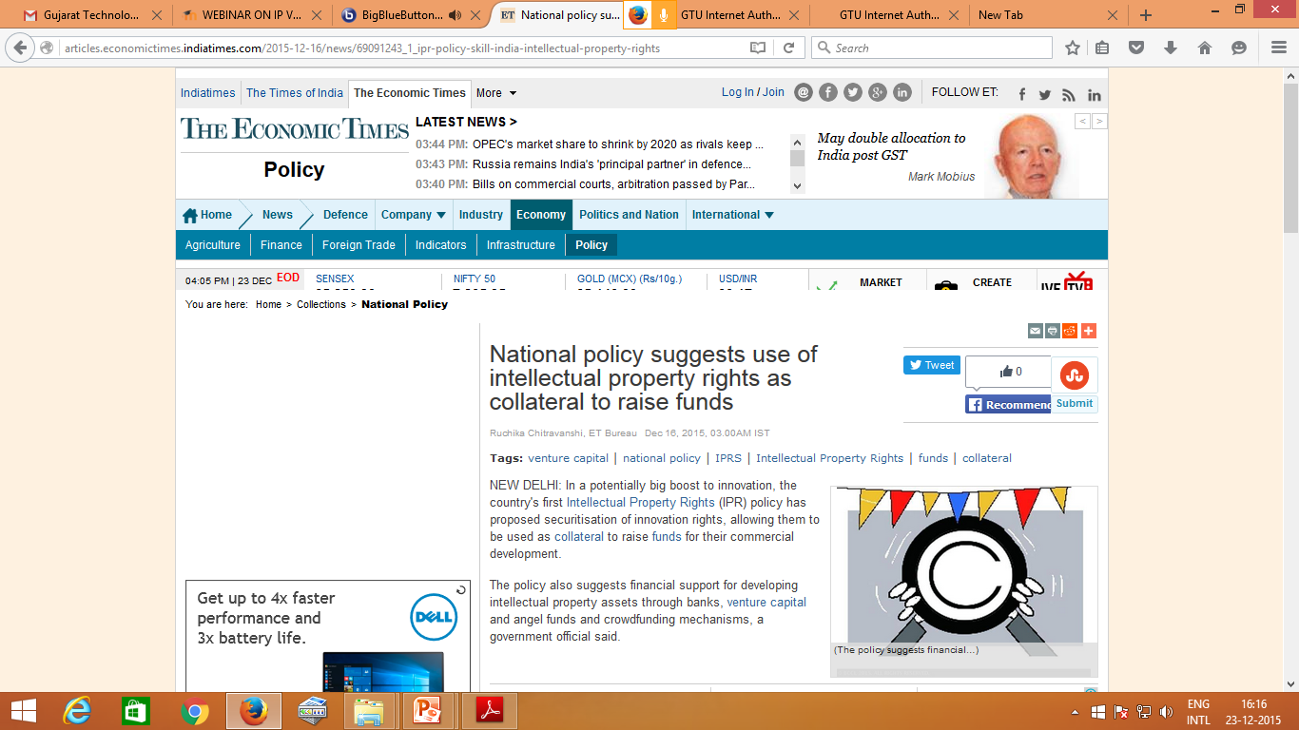

Slide 28
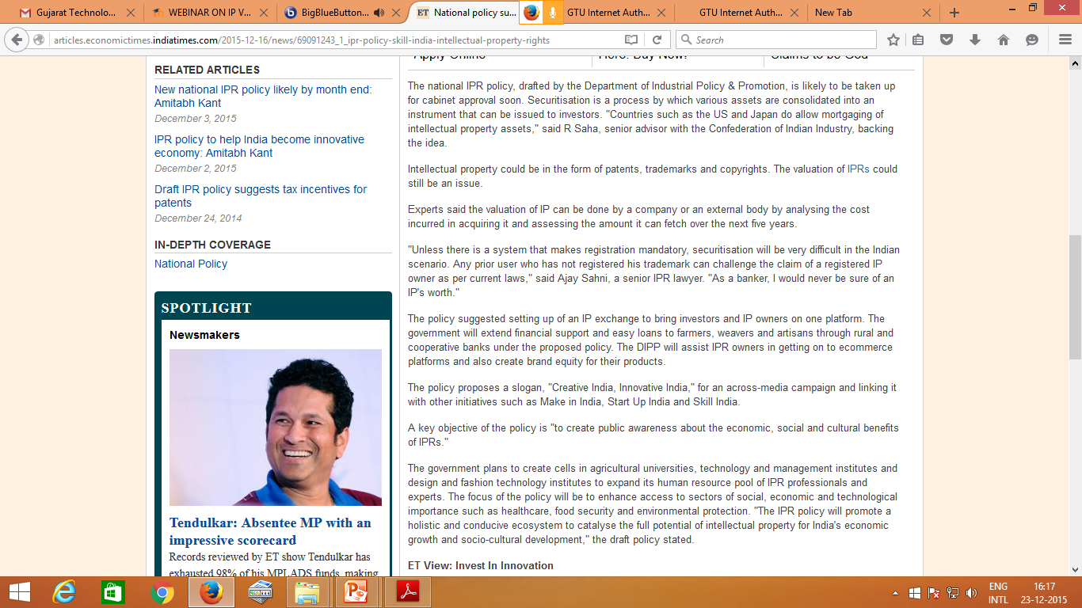

Slide 29
Unique initiative of GTU to launch 1st time in India
“Certificate course in IP Valuation & Management”
(Online / Offline Program)

Slide 30
Further, to increase the skilled human resource that are not only technically sound but also having in-depth knowledge of IP valuation and management, GTU is going to start
6 months Certification course on
“IP valuation and management” (IPVM) course from
January - 2016.

Slide 31
PROGRAM STRUCTURE
Name of Course | Duration | Mode of study
Certification course on “IP Valuation and Management” | 6 month 2 days per month (Usually Saturday & Sunday) (Total 12 contact days) | Offline and Online

Slide 32
OVERVIEW OF THE COURSE
Overview about intangible assets and their protection
Indian and International Patent system
Qualitative and Quantitative characteristics of the IP.
Valuation Basics
IP Valuation Methods and Approaches
Earnings capacity and profitability relating to the IP.
Product life cycles and positioning.
IP Portfolio & its management
Intellectual Property and Commercialization

Slide 33
UNIQUE FEATURES OF THIS COURSE
Off campus and online mode Program (Candidates can take up this course with his/ her ongoing study or job)
72 hours of contact classes (This is highest among all such kind of program)
IP valuation and Management combine programme (This is 1st time offered comprehensive programme)
Video recorded session will be available to revision purpose
Case study based learning (Each module will be supplemented with case study)
Faculty from GTU, reputed law firms, IPR/TT cells of Industry, Patent Officers, reputed and Foreign Experts will conduct the contact classes (This is to get diversified pull of expertise)

Slide 34
WHO SHOULD JOIN?
Students / faculty from M. Pharma, M. Engineering, MBA or MCA or LLB/LLM Discipline
IP Professionals / Legal Professionals / Marketing Consultants
Directors / CEO / CFO / COO
Strategic Business Managers / Business Development Officers
Start-Up Incubator Managers
Angel investors/ Venture capitalists
Bankers / Government officials for Industrial promotion
Chartered Accountant (CA) / Company Secretory (CS)

Slide 35
Few Likely Benefit of this course
Career as IP Valuator
Career as IP Portfolio Manager
Consultant for IP Valuation
Consultant for Managing IP Portfolio
Technology Transfer Officer (TTO)
New Start Up venture
Enhance scope of current services offering to your clients by providing IP valuation services
Helpful during IP litigation in courts

Slide 36
Helpful during Merger & Acquisition, Brooking of shares, Brand acquisition and like
To decide product portfolio for future growth of company
Product to be put off market/On market
Brand acquisition and like
To take decision in investment into Start Ups
Quantify investment required and understand expected outcome of investment done in Start Ups/MSME
To decide quantum of loan eligibility to Start Ups and MSME on the basis of Intellectual property that they possess
To quantify intangible assets of their clients, which will be helpful during M & A, Goodwill/Brand value passoff/licensing/selling and like

Slide 37
Fee structure
Category | Eligibility Criteria | Fees (INR) | # Fees (USD)
Student | Student currently pursing Master/LLB/ PhD in any discipline (Science/Technical/Commerce/Arts) OR Student currently pursing CA/CS exam and having graduation degree from any recognized University. | 18,000 ₹ | 1000 $ (*300 $)
Faculty | Faculty member from any recognized College/Institute OR University | 21,000 ₹ | 1500 $ (*500 $)
Any working Professional | Any working professional OR person possessing graduation degree from any recognized University. | 25,000 ₹ | 2000 $ (*700 $)

Slide 38
HOW TO APPLY?
Candidate can fill up the form attached separately with this circular. Fill up all details and send the form with necessary documents along with payment challan Fees (as per your category) using online SBI to GTU, Chandkheda address with subject on the cover “Application for Certification course on IP valuation and management”.

Slide 39
IMPORTANT DATES
Forms available from : 12th December 2015, Saturday
Last date of submission of forms : 09th January 2016, Saturday
Commencement of Course : Last week of January, 2016

Slide 40
IMPORTANT Documents
Circular: http://files.gtu.ac.in/circulars/15DEC/14122015_02.pdf
Application Form:
http://files.gtu.ac.in/circulars/15DEC/14122015_03.pdf
Website: www.gtuipr.gtu.ac.in

Slide 41
For any clarification or query kindly contact
Dr. Manish A. Rachchh
manish.rachchh@gtu.edu.in
(M) +91-9909961894 Mr. Amit Patel
ipr_projectofficer@gtu.edu.in
(M) +91- 9898801467 Mr. Shailesh Jain
po_ipr@gtu.edu.in
(M) +91- 7359298134

Slide 42
We welcome you to join very Unique and Emerging branch of IP Valuation & Management
www.gtuipr.gtu.ac.in
Thank You

Slide 43
Questions
?????

